Slide 1
Internet Security (CI6240)
Week 4 – Digital Symmetric Ciphers
Dr Martin Tunnicliffe
M.J.Tunnicliffe@kingston.ac.uk
Dr Eckhard Pfluegel
E.Pfluegel@kingston.ac.uk

Slide 2
Teaching Block 1
Introduction
Mathematical Primer
Classical Cryptography
Digital Symmetric Ciphers
Public Key Cryptography
(Reading Week)
Cryptographic Hash Functions
Networks and Network-Based Attacks
Firewalls and Secure Architectures
Cryptography on the Internet
In-Class Test 1
TB1 Wrap-Up

Slide 3
Topics Covered
Block and Stream Ciphers
One Time Pads
The Feistel Function
Introduction to DES
Simplified DES
Full DES
Random Number Generation
DES Modes of Operation
Cryptanalysis of DES
Other Block Ciphers (AES, Blowfish, Red Pike)
Notes:
These topics are not exhaustive, and the concepts will be built upon considerably in the coming weeks.

Slide 4
1.
Block and Stream Ciphers

Slide 5
Stream Ciphers
Stream Cipher:
  Takes one plaintext character at a time and converts it to a ciphertext character.
  Last week’s substitution ciphers are stream ciphers.
p1.p2.p3.p4...
PLAINTEXT SYMBOLS
c1.c2.c3.c4...
CIPHERTEXT SYMBOLS
CIPHER

Slide 6
Stream and Block Ciphers
Block Cipher:
  Takes a block of plaintext (e.g. 64 bits) and encodes it into equal-sized block of ciphertext.
  Last week’s columnar transposition cipher is a block cipher
p1.p2.p3.p4
p5.p6.p7.p8
PLAINTEXT BLOCKS
kr49dfg20oe
CIPHERTEXT BLOCKS
CIPHER
8flyow2ien1

Slide 7
Advantages and Drawbacks
Stream ciphers:
  Are faster and use less memory than block ciphers
  Are more difficult to implement than block ciphers
Block ciphers:
  Are easy to combine with mechanisms that provide integrity and authentication.
  Can be made to behave as stream ciphers, but stream ciphers cannot be made to work as block ciphers
  Are more prone to noise corruption (one corrupted bit often makes the whole block unreadable).

Slide 8
2.
One Time Pads

Slide 9
What is a “One Time Pad”?
Essentially a Vigenère cipher in which the key is longer than all messages combined
  Typically a stream of random numbers
  Infinite period – no repetitions – truly unbreakable!
  Problem: Key Distribution…
Encryption
Decryption
Addition Modulo n
Subtraction Modulo n
Plaintext
Plaintext
Ciphertext
Random Number Source
Key Sharing Mechanism
Notes:
Remember pseudorandom sequences from the Hedy Lamar/George Antheil exercise in the first week? We will study pseudorandom – as well as true-random numbers - in more detail next week.
Quantum cryptography is a topic covered in TB2.

Slide 10
One Time Pad Example
Plaintext | Encoded Plaintext | Random Key | Encryption | Decryption | Decoded Plaintext
C | 2 | 81 | (2+81) mod 26=5 | (5-81) mod 26=2 | C
I | 8 | 74 | (8+74) mod 26=4 | (4-74) mod 26=8 | I
P | 15 | 40 | (15+40) mod 26=3 | (3-40) mod 26=15 | P
H | 7 | 3 | (7+3) mod 26=10 | (10-3) mod 26=7 | H
E | 4 | 48 | (4+48) mod 26=0 | (0-48) mod 26=4 | E
R | 17 | 87 | (17+87) mod 26=0 | (0-87) mod 26=17 | R
S | 18 | 17 | (18+17) mod 26=9 | (9-17) mod 26=18 | S

Slide 11
Pseudorandom Numbers
Pseudorandom numbers seem to be random, but they are always the same for any given “seed” number (will be covered in detail later)
(PRNG=Pseudo Random Number Generator)
Seed 114
PRNG
119, 166, 226, 55, 214, 60, 131, 150…
Seed 30
PGRN
101, 248, 52, 186, 46,110 90, 180, 188…

Slide 12
Key Distribution
Sender and receiver can construct the same pseudorandom sequences if they have access to the same seed
Also secure mathematical methods to share random numbers (basis of the Elgamal cipher).
Also “Quantum Key Distribution” (QKD) – see https://www.youtube.com/watch?v=tG9ZiMLanhE
Encryption
Decryption
Addition Modulo n
Ciphertext
Subtraction Modulo n
Plaintext
Ciphertext
Shared “Seed”
PRNG
PRNG

Slide 13
3.
The Feistel Function

Slide 14
“Strongly Ideal” Cipher
Problem:
  A key often leaves its “imprint” in the ciphertext of block cipher.
  Simple example: bigrams visible in ciphertext of columnar cipher give clue about repetition period.
Strongly Ideal Cipher:
  Proposal by Claude Shannon in 1949
  Block cipher in which the ciphertext statistics are is independent of the key.
  Example: An Arbitrary Substitution Cipher…

Slide 15
Arbitrary Substitution Cipher
3-bit Plaintext Block
All Possible Messages
3-bit Ciphertext Block
0
1
0
0
0
1
000
000
001
001
010
010
011
011
3-8 Decoder
8-3 Encoder
100
100
101
101
110
110
111
Key A
111
Decoder Truth Table
Encoder Truth Table
Input |  |  | Output
0 | 0 | 0 | 1 | 0 | 0 | 0 | 0 | 0 | 0 | 0
0 | 0 | 1 | 0 | 1 | 0 | 0 | 0 | 0 | 0 | 0
0 | 1 | 0 | 0 | 0 | 1 | 0 | 0 | 0 | 0 | 0
0 | 1 | 1 | 0 | 0 | 0 | 1 | 0 | 0 | 0 | 0
1 | 0 | 0 | 0 | 0 | 0 | 0 | 1 | 0 | 0 | 0
1 | 0 | 1 | 0 | 0 | 0 | 0 | 0 | 1 | 0 | 0
1 | 1 | 0 | 0 | 0 | 0 | 0 | 0 | 0 | 1 | 0
1 | 1 | 1 | 0 | 0 | 0 | 0 | 0 | 0 | 0 | 1
Input |  |  |  |  |  |  |  | Output
1 | 0 | 0 | 0 | 0 | 0 | 0 | 0 | 0 | 0 | 0
0 | 1 | 0 | 0 | 0 | 0 | 0 | 0 | 0 | 0 | 1
0 | 0 | 1 | 0 | 0 | 0 | 0 | 0 | 0 | 1 | 0
0 | 0 | 0 | 1 | 0 | 0 | 0 | 0 | 0 | 1 | 1
0 | 0 | 0 | 0 | 1 | 0 | 0 | 0 | 1 | 0 | 0
0 | 0 | 0 | 0 | 0 | 1 | 0 | 0 | 1 | 0 | 1
0 | 0 | 0 | 0 | 0 | 0 | 1 | 0 | 1 | 1 | 0
0 | 0 | 0 | 0 | 0 | 0 | 0 | 1 | 1 | 1 | 1
8 possible messages
8 internal connections
8! or 40320 possible keys
Key B

Slide 16
Arbitrary Substitution Cipher
64-bit Plaintext Block
All Possible Messages
64-bit Ciphertext Block
…
…
000…00
000…00
000…01
000…01
000…10
000…10
64-2⁶⁴Decoder
2⁶⁴-64Decoder
111…10
111…10
111…11
Key
111…11
64-bit Arbitrary Substitution block cipher
  Block size used in DES
  2⁶⁴ possible messages so 2⁶⁴ internal connections
  2⁶⁴ =18,446,744,073,709,551,616 (≈18 billion billion)
    About the number of grains of sand in the world
  Not Practical!

Slide 17
The Feistel Function
The Arbitrary Substitution Cipher uses confusion
  Relies exclusively on confusion to obscure relationship between the ciphertext and the key
  Creates a genuine Strongly Ideal Cipher
  We have shown this is not practical
Feistel Function
  Proposed by Horst Feistel in 1973
  Combines confusion with diffusion (“product” cipher)
  Approximates a Strongly Ideal Cipher

Slide 18
The Feistel Function
Operations used:
  Confusion (substitution) – obscures key
    Provided by S-boxes (look-up tables for substitution)
  Diffusion (transposition) – makes one input bit change affect several output bits
    Provided by bit-permutations (re-ordering of bits with words)
  Also makes use of the XOR operation
    Used to introduce key and to re-combine separated half-blocks of data
  Sequences of these operations are applied iteratively (repeatedly) over several rounds

Slide 19
4.
Introduction to DES

Slide 20
The Data Encryption Standard (DES)
Developed for the US government (1976)
  By IBM after call of National Bureau of Standards
  Accepted as international cryptographic standard
Characteristics:
  64-bit plaintext to 64-bit ciphertext
  56-bit key (over 70,000,000,000,000,000 ciphers)
Makes extensive use of the Feistel Function
  Several other block ciphers use Feistel techniques as well

Slide 21
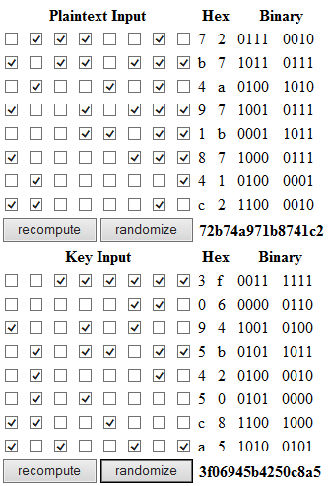
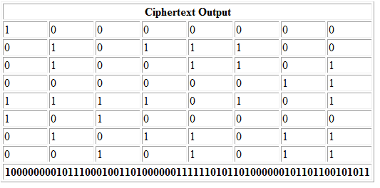
Demo Implementation
Test this for yourself (DES-TEST.html):
  Changing one bit of the plaintext changes many bits in the ciphertext block.
  Changing one bit of the key changes many bits in the ciphertext block.
64 key bits are reduced to a 56 bit “actual” key
  8 bits are reserved for parity error check.
  “Should” make number of 1’s in each line odd
Parity Bits
Notes:
You’ll notice that in this screenshot the number of 1’s in each line is not necessarily odd. That is because the parity bits are not correctly set. This has no effect whatsoever on the cipher operation.

Slide 22
The Data Encryption Standard (DES)
Has never been mathematically cracked
  Can be cracked by brute force (getting easier)
  Can be strengthened by iterative use, e.g. 3DES
Still the most important symmetric encryption algorithm
  Will eventually be replaced by the Advanced Encryption Standard (AES)
Easy to implement
  Available as single-purpose chip

Slide 23
5.
Simplified DES (S-DES)

Slide 24
Simplified DES (S-DES)
Scaled-down version of DES developed by Edward Schaefer in 1996 for educational use
S-DES key-length is 10 bits
  Full DES has 56-bit key
S-DES block size is 8 bits
  Full DES uses 64-bit blocks
S-DES has 2 rounds of confusion/diffusion
  Full DES has 16 rounds
S-DES not generally useful as a practical cipher

Slide 25
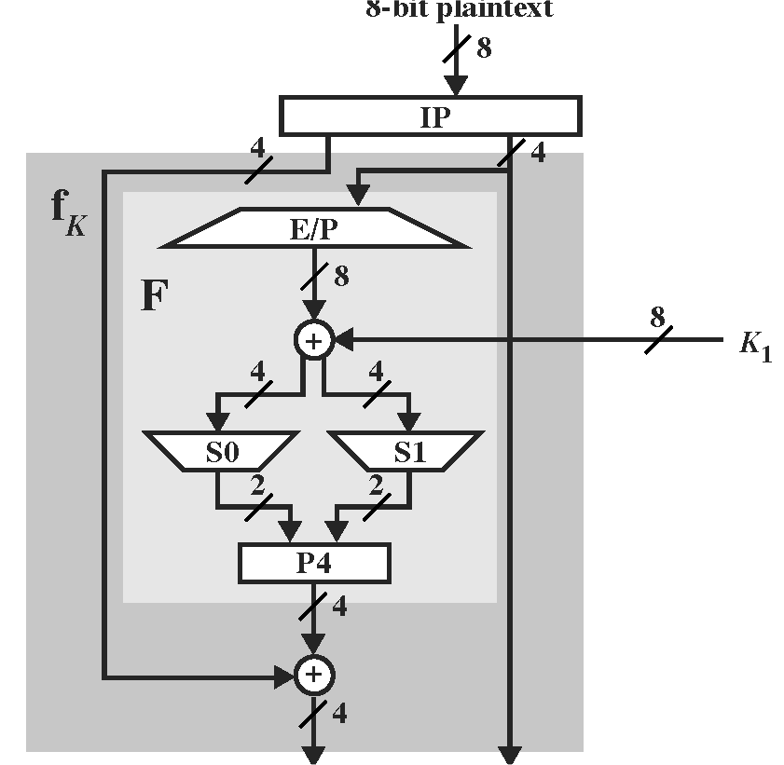
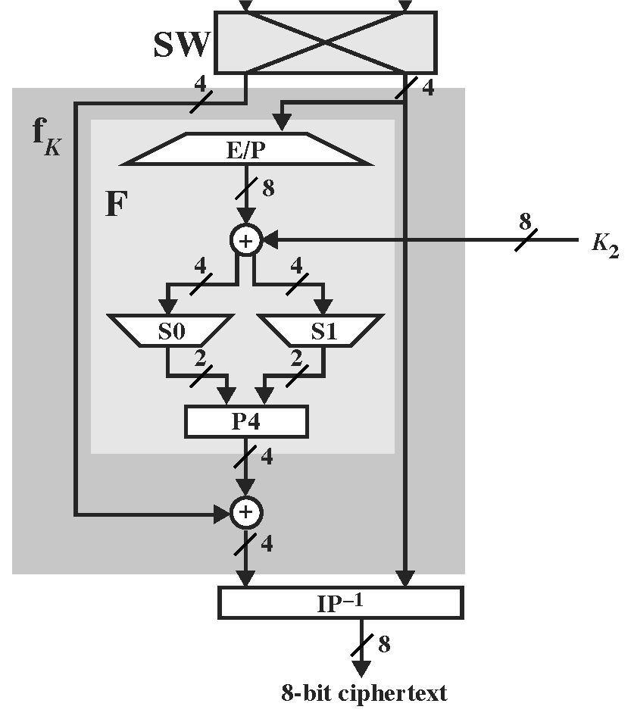
S-DES Architecture
Notes:
Since there are only two rounds, there are only 2 round keys
They are eight bits each, obtained from a 10 bit key (see later how this is done)
The “F” is the Feistel function
E/P and P4 provide diffusion (moving/duplicating bits between positions)
The S-boxed “S0” and “S1” provide confusion (substitution)

Slide 26
S-DES Initial and Final Permutations
Initial Permutation (IP)
2 | 6 | 3 | 1 | 4 | 8 | 5 | 7
Final Permutation (IP⁻¹)
4 | 1 | 3 | 5 | 7 | 2 | 8 | 6
These are inverse operations:
Input is 10101010
IP gives: 00110011
IP⁻¹ gives: 10101010

Slide 27
Operations in the Feistel Function
Expand/Permutate (E/P)
4 | 1 | 2 | 3 | 2 | 3 | 4 | 1
Expands a 4-bit number into an 8-bit number
Example: 1001 becomes 11000011
Permutate 4 (P4)
2 | 4 | 3 | 1
Rearranges a 4-bit number into another 4-bit number
Example: 1001 becomes 0101

Slide 28
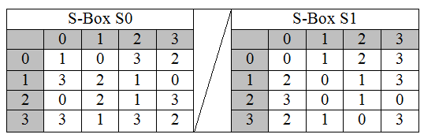
Operations in the Feistel Function
Input Bits: b0 b1 b2 b3
Row number: b0 b3, Column number: b1 b2
Example: Input: 0101
Row number: 01=decimal 1
Column number: 10=decimal 2
In S0 output=decimal 1=01
In S1 output=decimal 1=01

Slide 29
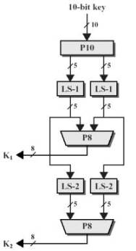
S-DES Round Key Generation
Permutate 10 (P10)
3 | 5 | 2 | 7 | 4 | 10 | 1 | 9 | 8 | 6
Permutate 8 (P8)
6 | 3 | 7 | 4 | 8 | 5 | 10 | 9
Left Shift 1 (LS-1)
2 | 3 | 4 | 5 | 1
Left Shift 2 (LS-2)
3 | 4 | 5 | 1 | 2

Slide 30
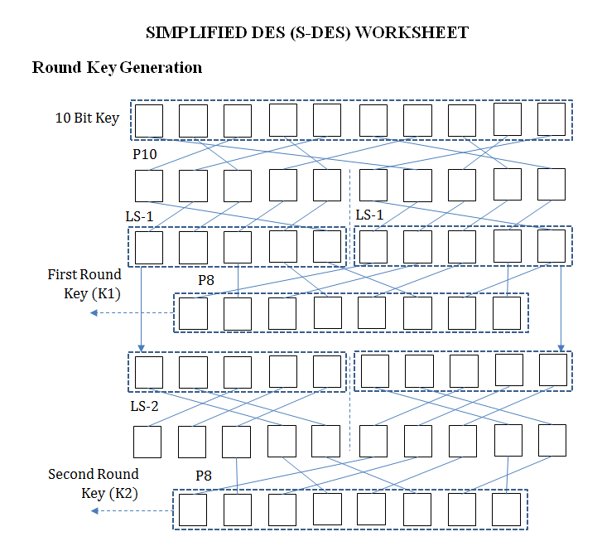
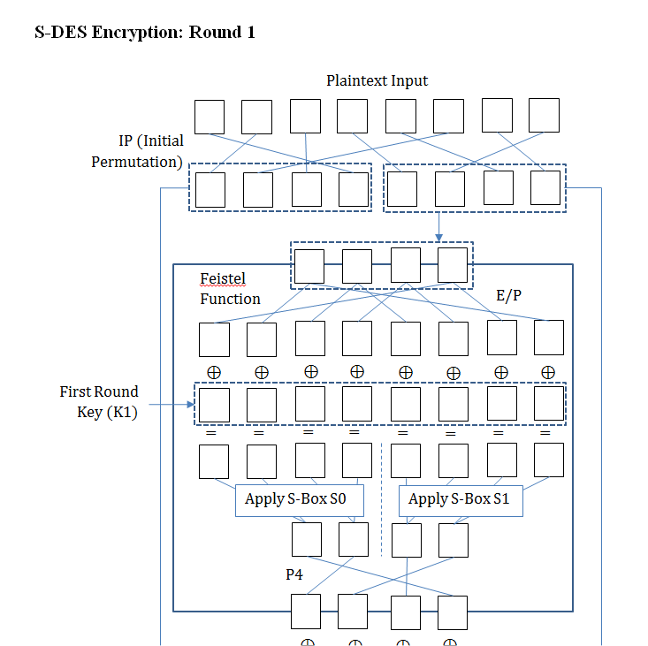
S-DES Worksheet

Slide 31
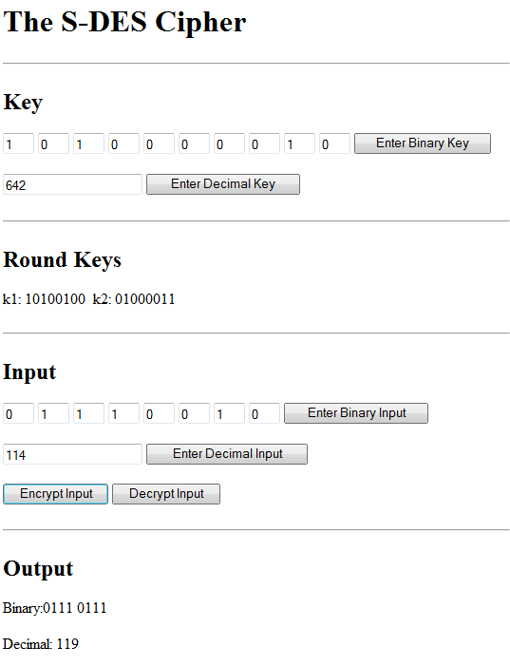
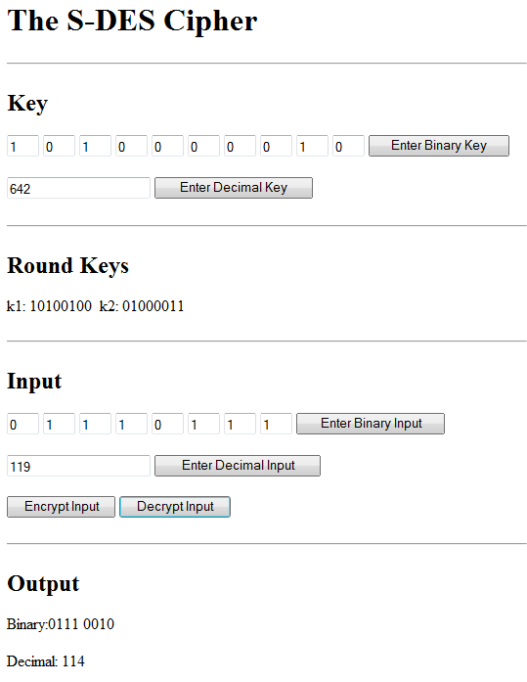
S-DES JavaScript Simulator

Slide 32
6.
Full DES

Slide 33
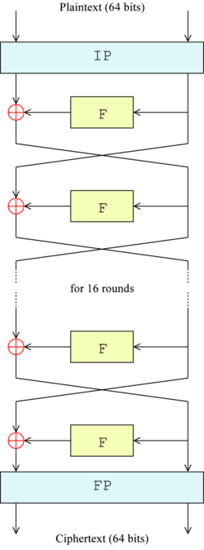
The Full DES Algorithm
Obtain sixteen 48-bit “round keys” from the 56-bit key.
Split data into 64-bit blocks.
For each 64-bit block:
  Perform initial permutation
  Split into two 32-bit sub-blocks
  Execute Feistel function (using first round key) on one sub-block.
  Bitwise XOR with other sub-block
  Swap two halves over and repeat 15 times using scheduled round keys.
  Perform final permutation to obtain ciphertext.
Key schedule is reversed for decryption (just as it was in S-DES).
1st round key
32 bits
32 bits
2nd round key
15th round key
16th round key
(IP⁻¹)
KEY
(56 bits)

Slide 34
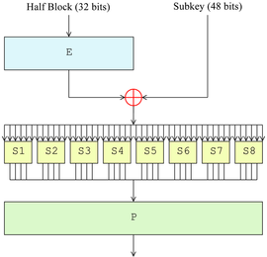
The Full DES Feistel function
Half Block
(32 bits)
48-bit Round Key
Compare both this diagram and the previous one with the S-DES algorithm and note the close similarity.
E/P
Expand to 48 bits
“Substitution Boxes”
(Lookup Table)
Transpose according to fixed permutation

Slide 35
7.
Random Number Generation

Slide 36
Random Number Generation
Why are random numbers needed?
  Some ciphers use them to “mask” plaintext values (e.g. One Time Pad, Elgamal).
  To provide key values automatically.
They are generated automatically by the computer using a “random number generator”.
But computers are “deterministic”…
  They always produce the same output for any given sequence of inputs
  So how do they generate anything truly random?

Slide 37
Pseudo-Random Numbers
Computers actually do contain a few truly random elements (called “entropy sources”), e.g.
  Keystrokes from users
  Disk drive speed variations
  Light variations in mobile phone cameras
These random numbers “seed” mathematical/logical processes which produce seemingly random numbers.
  Pseudo-Random Number Generators (PRNGs).
  PRNGs often make use of block cipher algorithms.
Notes:
Some very modern computer chips do contain true random number generation units, but these are still usually used to seed built-in PRNG’s in order to produce random numbers fast enough.
Other cryptographic algorithms are also used to make PRNG’s, including public-key ciphers and hash functions.

Slide 38

Pseudo-Random Number Generation
“Seed”
Input Value V
Entropy Source
Cipher Algorithm
Key
This is called an “Output Feedback (OFB) Mode” PRNG.
Other schemes also exist.
Pseudo-Random Number Sequence

Slide 39
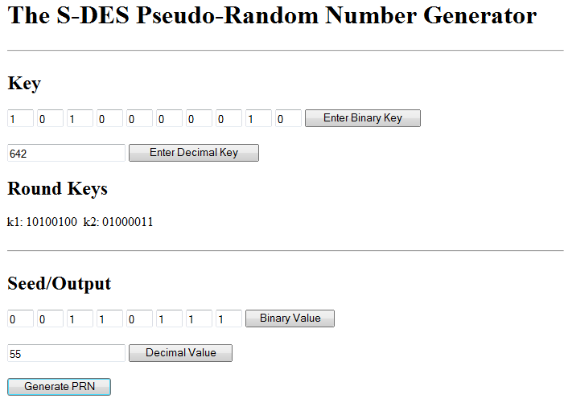
Demonstration PRNG Using S-DES
How good a random number generator is this?
That is one of the things you will be investigating in this week’s workshop!

Slide 40

“True” Random Number Generation
1 RESET
1
0
OUTPUT 0
“Released”
Can go either way
1
1
System externally forced into an “illogical” state
“True Entropy” (random thermal movement of electrons, external interference etc.)
0
1
OUTPUT 1
Included in some multi-core Intel processor chips.
True Random Number Generator (TRNG) much slower than PRNG.
In practice it is used to seed a PRNG periodically.
There are also some online TRNG services – check out http://www.random.org/
Notes:
Another example of a TRNG is E.R.N.I.E. (Electronic Random Number Indicating Equipment) which chooses winning Premium Bond numbers

Slide 41
8.
DES Modes of Operation

Slide 42
Electronic Code Book (ECB) Mode
The classic mode of DES operation
Takes plaintext 64 bits at a time
Produces a series of 64-bit ciphertext blocks
Useful for sending small amounts of data
Long structured messages can be vulnerable to cryptanalysis
  Particularly if they contain known repetitive elements.
  Potentially give the attacker a set of plaintext/ciphertext samples.

Slide 43
Cipher Feedback (CFB) Mode
Allows DES to work as a stream cipher (several other DES operation modes exist)
64 bits randomly chosen
Input Vector (IV)
COPY
64-s bits
s bits
COPY
Shift s bits
Key
Key
Encrypt DES
Encrypt DES
s bits
64-s bits
s bits
64-s bits
Etc.
1st Plaintext Symbol
(s bits)
2nd Plaintext Symbol
(s bits)
XOR
1st Ciphertext
Symbol
(s bits)
XOR
2nd Ciphertext
Symbol
(s bits)
Notes:
The 64-bit block (shifted s-bits during the round) is copied to the next round where it is shifted another s bits

Slide 44
CFB Decryption
Principle: Each ciphertext bit must be XOR’d with the same value as during encryption
64 bits randomly chosen
Input Vector (IV)
COPY
64-s bits
s bits
COPY
Shift s bits
Key
Key
Encrypt DES
Encrypt DES
s bits
64-s bits
s bits
64-s bits
Etc.
1st Plaintext Symbol
(s bits)
1st Ciphertext
Symbol
(s bits)
2nd Plaintext Symbol
(s bits)
2nd Ciphertext
Symbol
(s bits)
XOR
XOR
Note: this is really just a One Time Pad using a commonly-seeded PRNG to create the key
Notes:
Note that both the receiver and the transmitter need access to the same IV-value. DES has several other defined operation modes which we shall not cover.
The only difference from the one time pad described earlier is that XOR is used in place of addition.

Slide 45
9.
Cryptanalysis of DES

Slide 46
Cryptanalysis
DES has never been mathematically compromised
2⁵⁶≈72,000,000,000,000,000 possible keys.
  Brute force attack feasible
Theoretical hardware “cracking machines”
  Diffie and Hellman (1977): Crack DES in 24 hours, cost $20,000,000 (US)
  Wiener (1993): Cracks DES in 7 hours, cost $1,000,000 (US)
Practical attack: COPACOBANA (2008)
  Dedicated hardware (http://www.copacobana.org/)
  Cracking time 1 week. Cost $1,000 (US)
Notes:
Information about COPACOBANA: Gunseysu et al., “Cryptanalysis with COPACOBANA”, IEEE TRANSACTIONS ON COMPUTERS, VOL. 57, NO. 11, NOVEMBER 2008. Also check out http://www.copacobana.org/.
An interesting paper about brute-force cryptography: http://www.eetimes.com/document.asp?doc_id=1279619#msgs

Slide 47
Modern PC’s and Supercomputers
Modern multi-core PC could perform 10⁹ DES decryptions per second.
  There are 7.2×10¹⁶ possible keys so do the sum yourself!
  Around 2.28 years to check all possible combinations.
With a modern supercomputer (about $10,000,000) around 10¹³ DES decryptions per second.
  Could try all possible DES keys in about 2 hours

Slide 48
Strengthening DES
Problem with DES: length of key is fixed to 56 bits
Double DES (2DES):
  Idea: use double encryption E(k₂, E(k₁, P))
  Two different keys, so effective key length 112 bits!
  However: this turns out to only double the strength of algorithm. (Vulnerable to “meet-in-the-middle” attacks.)
Triple DES (3DES-EDE):
  Principle: C = E(k₁, D(k₂, E(k₁, P))
  P = D(k₁, E(k₂, D(k₁, P))
  Still has an effective key length of 112 bits.
  But- significantly strengthens the algorithm.

Slide 49
10.
Other Block Ciphers

Slide 50
Advanced Encryption Standard AES
Response to DES Weaknesses
Adopted by US government in 2001 after 5-year competition
  Winning Algorithm is known as Rijndael
Strong mathematical foundation
  Uses substitution, transposition, shift, XOR and addition
  The Rijndael algorithm itself is an MSc-level topic
    Requires knowledge of matrices and finite field theory.
AES is openly published and has become one of the most popular symmetrically encryption algorithms

Slide 51
Comparison of DES and AES
64 Bit Plaintext Block
DES
64 Bit Ciphertext Block
56 Bit Key
128 Bit Plaintext Block
AES
128 Bit Ciphertext Block
Choice of Key Size
128 Bits
192 Bits
256 Bits
Notes:
Original Rijndael algorithm allowed block sizes 128, 192 and 256 bits. The official AES specification limits the block size to 128 bits.

Slide 52
Comparison of DES and AES
DES:
  No significant flaws found
  Has fixed key size
  Has fixed number of cycles (16)
  Was finally cracked (but great effort needed)
AES:
  Question of flaws cannot be answered yet
  Possible to extend key length and number of cycles
  At present: seems to be significant improvement over DES

Slide 53
Blowfish Cipher
Designed in 1993 by Bruce Schneier
  Was a competitor for AES (was beaten by Rijndael)
Another symmetric cipher, improving on DES
  Still based on the Feistel idea
Advantages:
  “Free” (no patents)
  Very fast
  Very memory efficient
Disadvantage: there is a class of key-values known to be vulnerable to cryptanalysis
Nowadays, different algorithms recommended (“Twofish” and “Threefish”)

Slide 54
Red Pike
Cipher adopted by United Kingdom government, for potential use by NHS
Algorithm is not published anywhere
All information known:
  block-cipher with a 64-bit block size and 64-bit key
  uses only basic operations (add, XOR, shift left)
  “…it requires only five lines of code.” (true or false?)
    Alleged Red Pike source code has been leaked
Even the Wikipedia page is very brief!
Is available to approved contractors
Has been widely criticised

Slide 55
Summary
Definitions of Block and Stream Ciphers
One Time Pads
The S-DES Cipher
  How its round keys are generated
  How it encrypts and decrypts
The full-blown DES cipher
  Differences from S-DES
  Electronic Codebook and Cipher Feedback modes
  DES weaknesses strengthened versions (2 and 3DES)

Slide 56
Summary (cont.)
Examples of other block ciphers
  AES
  Blowfish
  Red Pike
True-Random and Pseudo-Random Numbers
  PRNG operation
  Use of block ciphers in PRNG’s

Slide 57
Homework (1)
Do the online quiz
Download and do the “Homework 4” exercises.
Revise all the material from Lecture 2 about prime numbers and modular arithmetic, especially the Euclidian Algorithm. Then…
Use the Euclidean Algorithm in order to compute the Greatest Common Divisor gcd(a,b) of the following integers:
  a=55, b=15
  a=100, b=21

Slide 58
Homework (2)
Use the Extended Euclidean Algorithm in order to compute the inverse of 13 modulo 75.
Watch the following YouTube video about the RSA Algorithm:
  https://www.youtube.com/watch?v=wXB-V_Keiu8
Don’t worry if you don’t follow the maths in the latter part of this video – we will go through it slowly next week.

